Slide 1

Lecture # 3,4
Computer Organization and
Assembly Language

Slide 2
Topics
General Purpose Registers
Segment Registers
Memory Organization
Pointer/Base Registers
Flag Registers

Slide 3
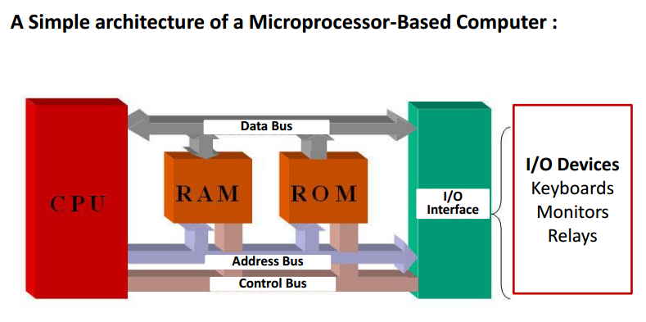
Simple Computer

Slide 4
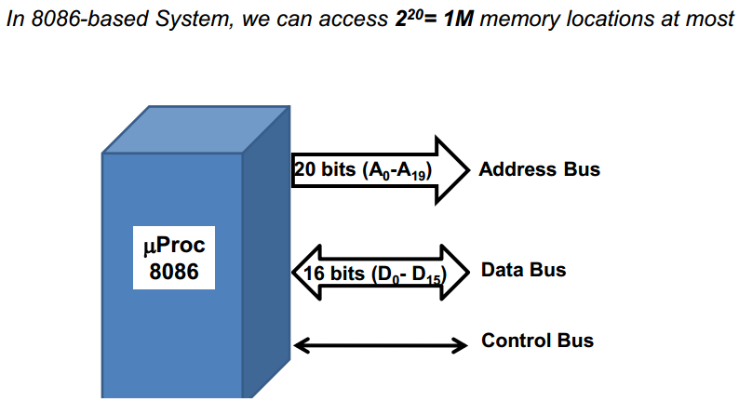
Intel 8086

Slide 5
Architecture of 8086
The architecture of 8086 includes
BIU
EU

Slide 6
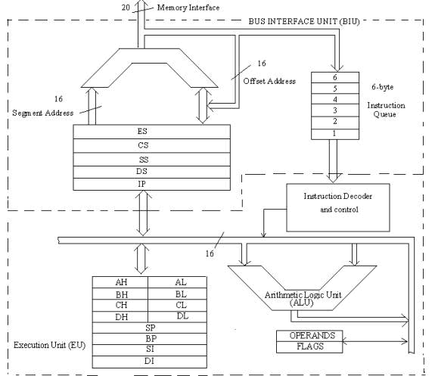
Intel 8086 Internal Architecture

Slide 7
Bus Interface Unit (BIU)
Functions of BIU
Fetch instructions or data from memory: It uses the Instruction Pointer (IP) and segment registers to generate the physical address.
Write data to memory: Transfers results from the Execution Unit (EU) to the appropriate memory location.
Read data from ports (I/O operations): Reads data from input devices or external I/O ports.
Write data to ports (I/O operations): Sends data to output devices or external I/O ports.

Slide 8
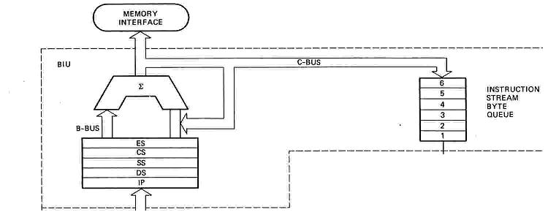
Bus Interface Unit (BIU)
Functional parts:
Instruction Queue (Q)
Segment Registers (CS, DS, ES, SS).
Instruction Pointer (IP).
Address Summing block (Σ)

Slide 9
1. Instruction Queue
The 8086 processor supports pipelining, meaning it fetches the next instructions while the current instruction is being executed.
The BIU prefetches up to 6 bytes of instructions from memory and stores them in the instruction queue.
This ensures that the Execution Unit (EU) does not have to wait for instructions to be fetched during execution.
How it works?
If an instruction takes more than 1 clock cycle to execute (like ADD AX, [2000H]), the BIU can keep fetching more instructions in parallel.
If a jump or branch occurs (e.g., JMP 2050H), the instruction queue is flushed, and new instructions are fetched from the new memory location.
Notes:
When the instruction queue in the Bus Interface Unit (BIU) is flushed, it means that all pre-fetched instructions stored in the queue are discarded (emptied) without being executed. This is necessary when the program flow changes unexpectedly, such as during a jump or branch instruction (e.g., JMP, CALL, or INT).

Slide 10


Segmented Memory
Physical Memory
Code segment (64KB)
Data segment (64KB)
Extra segment (64KB)
Stack segment (64KB)
00000
The memory in an 8086/88 based system is organized as segmented memory.
The CPU 8086 is able to address 1 MB of memory.
The Complete physically available memory may be divided into a number of logical segments.
1 MB
FFFFF

Slide 11
The size of each segment is 64 KB
A segment is an area that begins at any location which is divisible by 16.
A segment may be located any where in the memory
Each of these segments can be used for a specific function.

Slide 12
2. The Segment Registers (CS, DS, ES, SS)
These four 16-bit registers hold the base addresses of different memory segments in the 8086 architecture:
CS (Code Segment Register):
Holds the starting address of the code segment (where instructions reside).
Used with the IP to fetch instructions.
Example: If CS = 2000H, the instruction's base address is 20000H.
DS (Data Segment Register):
Stores the base address of the data segment (where variables and data are stored).
Example: Accessing data at offset 1000H from the DS = 3000H would give a physical address of:

Slide 13
2. The Segment Registers (CS, DS, ES, SS)
Physical Address = Segment Address x 10H + offset Address
Physical Address = (3000H × 10H) + 1000H = 31000H
ES (Extra Segment Register):
Used for extra data storage or string operations (like MOVSB for copying strings).
Works similarly to the Data Segment Register (DS).
SS (Stack Segment Register):
Stores the base address of the stack segment, used for managing function calls and temporary data.
Example: PUSH and POP instructions use the SS to manage the stack.

Slide 14
Segment Address
In computer architecture, particularly in x86 assembly language, segment address and offset address are used together to form a physical address in memory.
1. Segment Address:
The segment address is the base address that points to the beginning of a segment in memory.
Memory is divided into segments, such as the Code Segment (CS), Data Segment (DS), Stack Segment (SS), etc.
Each segment starts at a specific location in memory, indicated by the segment address.
The segment address is stored in a segment register, such as CS, DS, SS, or ES.

Slide 15
Offset Address
2. Offset Address:
The offset address is an address within the segment, specifying the exact location relative to the start of the segment.
It indicates how far, in bytes, a specific data or instruction is located from the segment's base address.
The combination of the segment address and offset address gives the exact physical location of the data or instruction in memory.

Slide 16
Physical Address
A physical address is the actual location in the computer's memory (RAM) where data or instructions are stored. It represents a unique memory location that the processor uses to access data, code, or other resources.
Calculation of Physical Address:
The physical address is calculated by combining the segment address and offset address using the formula:
Physical Address=(Segment Address×10H)+Offset Address
Physical Address = (Segment Address x 10H) + Offset Address
Physical Address=(Segment Address×10H)+Offset Address
Here, the segment address is multiplied by 16 (10H) because, in the x86 architecture, segments are considered to start at memory locations that are multiples of 16.

Slide 17
Example Explained
Given:
DS (Data Segment) = 3000H
Offset Address = 1000H
Step 1: Calculate the segment base address:
Segment Base Address=3000H×10H=30000H
Step 2: Add the offset to the segment base address to get the physical address:
Physical Address=30000H+1000H=31000H

Slide 18
3. The Instruction Pointer (IP)
The IP holds the offset address of the next instruction to be executed within the code segment (CS).
The combination of CS forms the physical address of the current instruction being fetched
Physical Address = (CS × 10H) + IP
How it works:
If CS = 2000H and IP = 0040H, the BIU generates the physical address 20040H to fetch the next instruction.
When an instruction executes, the IP is incremented automatically, pointing to the next instruction.

Slide 19
4. Address Summing Block (Σ)
This block performs the address calculation required for segmented memory addressing.
It adds the segment address (from a segment register) to the offset address (from the IP or another register).
Since each segment address is multiplied by 16 (10H), the summing block handles this conversion and computes the physical address.
How it works:
Example: If CS = 2000H and IP = 0040H, the Address Summing Block generates:

Slide 20
4. Address Summing Block (Σ)
Physical Address = (2000H × 10H) + 0040H = 20040H
The calculated physical address is used by the BIU to access memory.

Slide 21
Summary of BIU Components
6-Byte Instruction Queue: Holds pre-fetched instructions to enable pipelining.
Segment Registers (CS, DS, ES, SS): Hold base addresses of different memory segments (code, data, stack, extra).
Instruction Pointer (IP): Holds the offset of the next instruction to be executed.
Address Summing Block (Σ): Adds segment and offset addresses to generate the final physical address.
Together, these components allow the BIU to efficiently manage memory addressing and prefetch instructions, optimizing the performance of the 8086 processor.

Slide 22
Reason to multiply with 10h?
1. 20-bit Physical Address Requirement
The 8086 processor has a 20-bit address bus, which means it can address up to 1 MB of memory (2²⁰ = 1,048,576 bytes).
However, the segment registers (CS, DS, SS, ES) and the Instruction Pointer (IP) or other offsets are only 16 bits wide, which can hold values from 0 to 65535 (FFFFH).
2. Segment-Offset Addressing
To generate a 20-bit physical address, the 8086 processor uses two 16-bit values:
Segment address (from a segment register, e.g. CS)
Offset address (from IP or a general-purpose register)
The segment address stored in the segment register is treated as the starting point of a 64 KB block of memory

Slide 23
Reason to multiply with 10h?
Example: If the Code Segment (CS) register holds 2000H, the block of memory begins at address 20000H
3. Multiplication by 16 (10H)
To convert the 16-bit segment address into the starting physical address of a segment, the 8086 architecture multiplies the segment address by 16 (10H).
This multiplication shifts the segment address 4 bits to the left (equivalent to multiplying by 2⁴).
Reason: Since each segment can start only at addresses that are multiples of 16 bytes, multiplying the segment address ensures proper alignment in memory.

Slide 24
Reason to multiply with 10h?
CS = 2000H → Physical Address = 2000H × 10H = 20000H
4. Physical Address Calculation Example
If:
CS = 2000H
IP = 0040H
The physical address will be:
Physical Address = (CS × 10H) + IP
= (2000H × 10H) + 0040H
= 20000H + 0040H
= 20040H
Notes:
4. Physical Address Calculation Example
If:
CS = 2000H
IP = 0040H
The physical address will be:

Slide 25
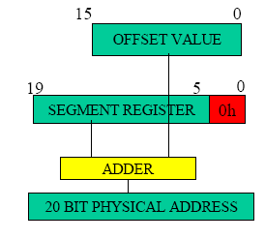
Forming Address

Slide 26
The following examples shows the CS:IP scheme of address formation:
CS
34BA
IP
8AB4
Code segment
34BA0
Inserting a hexadecimal 0H (0000B)
with the CSR or shifting the CSR
four binary digits left
8AB4 (offset)
3D645
3 4 B A 0 ( C S ) +
8 A B 4 ( I P )
3 D 6 5 4 (next address)
44B9F

Slide 27
Scenario: Simple Program Execution and I/O in Intel 8086
Let’s say the 8086 CPU needs to add two numbers from memory and display the result via a port connected to an output device (e.g., an LED or console).

Slide 28
1. Fetch Instructions or Data from Memory
Instruction: MOV AX, [1000H]
This instruction loads the value stored at memory address 1000H into the AX register.
How it works:
The Instruction Pointer (IP) contains the offset address of the next instruction (e.g., IP = 0040H).
The Code Segment (CS) register holds the segment address (e.g., CS = 2000H).
The BIU calculates the physical address suppose physical address is 20040H
The BIU fetches the instruction MOV AX, [1000H] from memory location 20040H and stores it in the instruction queue.
After decoding by the EU, BIU fetches the data from memory location 1000H to execute the instruction.

Slide 29
2. Write Data to Memory
Instruction: ADD AX, [2000H]
Assume the AX register contains the value 5, and the memory at 2000H stores 10. This instruction adds the value from memory to AX, making AX = 15.
Instruction: MOV [3000H], AX
This instruction stores the result (15) from AX into memory location 3000H.
How it works:
After the EU performs the addition, the BIU writes the result (15) from AX into memory location 3000H.

Slide 30
3. Read Data from Ports (I/O Operations)
Instruction: IN AL, 60H
This reads data from port 60H (e.g., a keyboard port).
How it works:
The BIU sends a request to port 60H, receives a byte of data (e.g., a key press), and stores it in the AL register.
Example: If the user presses the key ‘A’, the BIU reads the corresponding scan code from port 60H into AL
Notes:
Instruction: IN AL, 60H

Slide 31
4. Write Data to Ports (I/O Operations)
Instruction: OUT 80H, AL
This sends the data from AL to port 80H (e.g., an LED device)
How it works:
Assume AL contains the value 15 (the result of the addition).
The BIU writes the value 15 to port 80H to display it on an output device (like an LED screen or console).

Slide 32
Summary of the Example Execution
Fetch: BIU fetches the instruction MOV AX, [1000H] using IP and CS.
Write to Memory: BIU stores the result (15) at 3000H after the EU performs the addition.
Read from Port: BIU reads input from port 60H (e.g., keypress data).
Write to Port: BIU sends the result (15) from AL to port 80H for display.
This example demonstrates how the BIU manages memory and I/O operations in coordination with the EU.
Notes:
Summary of the Example Execution:
Fetch: BIU fetches the instruction MOV AX, [1000H] using IP and CS.
Write to Memory: BIU stores the result (15) at 3000H after the EU performs the addition.
Read from Port: BIU reads input from port 60H (e.g., keypress data).
Write to Port: BIU sends the result (15) from AL to port 80H for display.
This example demonstrates how the BIU manages memory and I/O operations in coordination with the EU.

Slide 33
A program consists of …
Data
Code
Stack

Slide 34
Different Areas in Memory
Code memory – Program can be located anywhere in memory
Data memory – The processor can access data in any one out of 4 available segments
Stack memory – A stack is a section of the memory set aside to store addresses and data while a subprogram executes
Extra segment – This segment is also similar to data memory where additional data may be stored and maintained

Slide 35
Segment Registers
Code Segment (CS) register is a 16-bit register containing address of 64 KB segment with processor instructions
The processor uses CS segment for all accesses to instructions referenced by instruction pointer (IP) register
Stack Segment (SS) register is a 16-bit register containing address of 64 KB segment with program stack
By default, the processor assumes that all data referenced by the stack pointer (SP) and base pointer (BP) registers is located in the stack segment.

Slide 36
Segment Registers
Data Segment (DS) register is a 16-bit register containing address of 64KB segment with program data
By default, the processor assumes that all data referenced by general registers (AX, BX, CX, DX) and index register (SI, DI) is located in the data segment
Extra Segment (ES) register is a 16-bit register containing address of 64 KB segment, usually with program data
By default, the processor assumes that the DI register references the ES segment in string manipulation instructions

Slide 37
Execution Unit (EU)
1. To tell the BIU where to fetch instructions and data
The EU works with the Instruction Pointer (IP) and segment registers (from the BIU) to generate the correct physical address.
It provides offsets or instructions to the BIU, helping it locate the correct memory addresses for fetching instructions and data.
2. To decode the instruction
Once the BIU fetches the instruction from memory, the EU decodes it to understand the operation that needs to be performed.
Example: An ADD AX, BX instruction is decoded to mean the contents of BX should be added to AX.
Notes:
2. To decode the instruction
Once the BIU fetches the instruction from memory, the EU decodes it to understand the operation that needs to be performed.
Example: An ADD AX, BX instruction is decoded to mean the contents of BX should be added to AX

Slide 38
Execution Unit (EU)
3. To execute instructions
The EU contains the Arithmetic Logic Unit (ALU), which performs arithmetic (e.g., addition, subtraction) and logical operations (e.g., AND, OR, NOT).
It uses the decoded instruction to determine what operation should be executed.
4. The EU contains the control to perform various operations
The Control Unit inside the EU coordinates and controls all activities required to execute the instruction.
It manages the sequence of operations, such as reading from registers, executing arithmetic, and storing results.

Slide 39
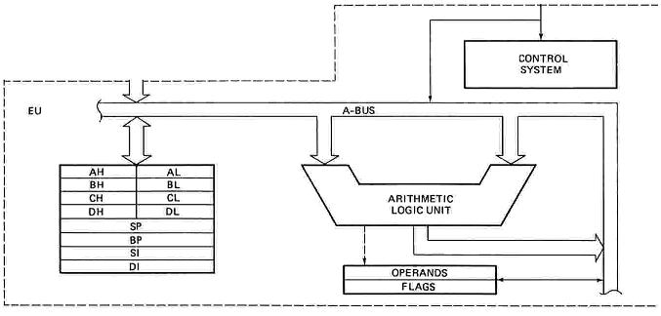
Execution Unit (EU)

Slide 40
Execution Unit (EU)
The Execution Unit (EU) has
Control unit
Instruction decoder
Arithmetic and Logical Unit (ALU)
General registers
Flag register
Pointers
Index registers

Slide 41
Instruction decoding process in the Intel 8086
Step 1: Fetching the Instruction
The 8086 processor fetches instructions from memory using its Bus Interface Unit (BIU).
These instructions are stored in a queue (like a small waiting line) that can hold up to 6 bytes.
Example: Suppose the instruction at memory location 1000 is ADD AX, BX. The BIU fetches this instruction and places it in the queue for the Execution Unit (EU) to process.
Step 2: Understanding the Instruction Format
In the 8086, instructions can vary in length from 1 to 6 bytes. Each instruction might consist of:
Opcode: Specifies the operation (e.g., addition, subtraction).
Operands: The data the operation will act on (e.g., registers like AX and BX).
Addressing Mode Information: Details about where the operands are located (memory, register, etc.).

Slide 42
Instruction decoding process in the Intel 8086
Example: The instruction ADD AX, BX might look like this in binary:
00000011 11000001
The first byte (00000011) is the opcode, which indicates an ADD operation.
The second byte (11000001) specifies that the registers involved are AX (destination) and BX (source).
Step 3: Decoding the Opcode
The Execution Unit (EU) reads the opcode and determines the operation to be performed.
In our example, the opcode 00000011 tells the processor that it should add the contents of one register (BX) to another register (AX).

Slide 43
Instruction decoding process in the Intel 8086
Step 4: Decoding Addressing Modes and Operands
After decoding the opcode, the EU figures out where to get the operands (data) for the operation.
In ADD AX, BX, both operands are registers, so no additional memory access is needed.
If the instruction involved memory, the EU would look for extra information, like displacement (offset) or segment information.
Step 5: Generating Control Signals
The EU generates control signals based on the decoded information. These signals direct the Arithmetic Logic Unit (ALU) to perform the addition.
It also decides which registers or memory locations will be used for storing the result.

Slide 44
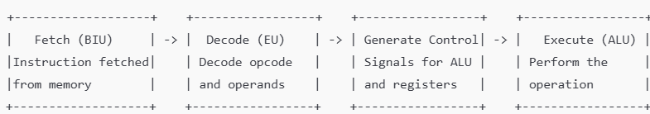
Instruction decoding process in the Intel 8086
Step 6: Executing the Instruction
Finally, the ALU performs the operation. For ADD AX, BX, it adds the contents of register BX to register AX.
The result is stored back in AX.
Example Instruction Decoding: ADD AX, BX
Fetch: The instruction ADD AX, BX is fetched from memory.
Decode: The EU decodes the opcode (ADD) and the operands (AX and BX).
Execute: The ALU adds the value in BX to the value in AX and stores the result in AX.

Slide 45
Real-World Example
MOV AX, 1234h
Fetch: The instruction MOV AX, 1234h is fetched from memory.
Decode: The EU decodes the MOV opcode, which means to move data. It identifies the destination as register AX and the source as the immediate value 1234h.
Execute: The value 1234h is loaded into the AX register.
The instruction decoding process in the 8086 microprocessor is all about breaking down the instruction into smaller parts to understand what operation needs to be performed, where the data is coming from, and where it should be stored. The processor's internal components work together to carry out these steps efficiently.

Slide 46
8086 Registers

Slide 47
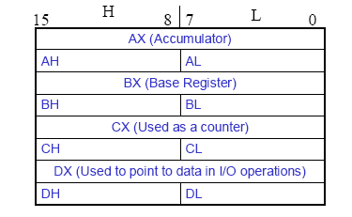
General Purpose Registers
AX - the Accumulator
BX - the Base Register
CX - the Count Register
DX - the Data Register
Normally used for storing temporary results
Each of the registers is 16 bits wide (AX, BX, CX, DX)
Can be accessed as either 16 or 8 bits AX, AH, AL

Slide 48
General Purpose Registers
AX
Accumulator Register
Preferred register to use in arithmetic, logic and data transfer instructions Must be used in multiplication and division operations
Must also be used in I/O operations
BX
Base Register
Also serves as an address register
usually contains a data pointer used for based, based indexed or register indirect addressing.

Slide 49
General Purpose Registers
CX
Count register
Used as a loop counter
Used in shift and rotate operations
DX
Data register
Used in multiplication and division
Also used in I/O operations

Slide 50
Execution Unit – General Purpose Registers
Register | Purpose
AX | Word multiply, word divide, word I /O
AL | Byte multiply, byte divide, byte I/O, decimal arithmetic
AH | Byte multiply, byte divide
BX | Store address information
CX | String operation, loops
CL | Variable shift and rotate
DX | Word multiply, word divide, indirect I/O (Used to hold I/O address during I/O instructions. If the result is more than 16-bits, the lower order 16-bits are stored in accumulator and higher order 16-bits are stored in DX register)

Slide 51
Execution Unit - Registers
Pointer Registers
Stack pointer and Base Pointer are used to access data in the stack segment.
SP: Stack pointer
– Used with SS to access the stack segment
Note: SP is used as an offset from the current SS during execution of instructions that involve the stack segment in external memory
BP: Base Pointer
– Primarily used to access data on the stack
– Can be used to access data in other segments

Slide 52
Execution Unit - Registers
Index Register
Source index register (SI) and Destination Index (DI) Registers are used in indexed addressing.
The index registers (SI & DI) and the BX generally default to the Data segment register (DS).
SI: Source Index register
– is required for some string operations
– When string operations are performed, the SI register points to memory locations in the data segment which is addressed by the DS register. Thus, SI is associated with the DS in string operations.

Slide 53
Execution Unit - Registers
DI: Destination Index register
– is also required for some string operations.
– When string operations are performed, the DI register points to memory locations in the data segment which is addressed by the ES register. Thus, DI is associated with the ES in string operations.
The SI and the DI registers may also be used to access data stored in arrays

Slide 54
Segment and Address register combination
CS:IP
SS:SP SS:BP
DS:BX DS:SI
DS:DI (for other than string operations)
ES:DI (for string operations)

Slide 55
Question
The Content of the Following registers are
CS=1111h
DS=1678H
ES=1298h
SS=6789H
IP =6721H
BX=7865H
BP=7821H
DI=1235H
Calculate the Corresponding Physical addresses for the address byte in CS,ES,DS and SS

Slide 56
Flags Register
In the Intel 8086 microprocessor, the flag register is a special 16-bit register that indicates the status of the CPU and the results of arithmetic or logical operations. It consists of individual bits called flags, where each bit represents a specific condition or control information about the processor. The flag register is divided into two main categories:
Status Flags: These flags indicate the outcomes of operations performed by the Arithmetic Logic Unit (ALU).
Control Flags: These flags are used to control the behavior of the processor.

Slide 57

Flags Register
15 14 13 12 11 10 9 8 7 6 5 4 3 2 1 0

